Slide 1
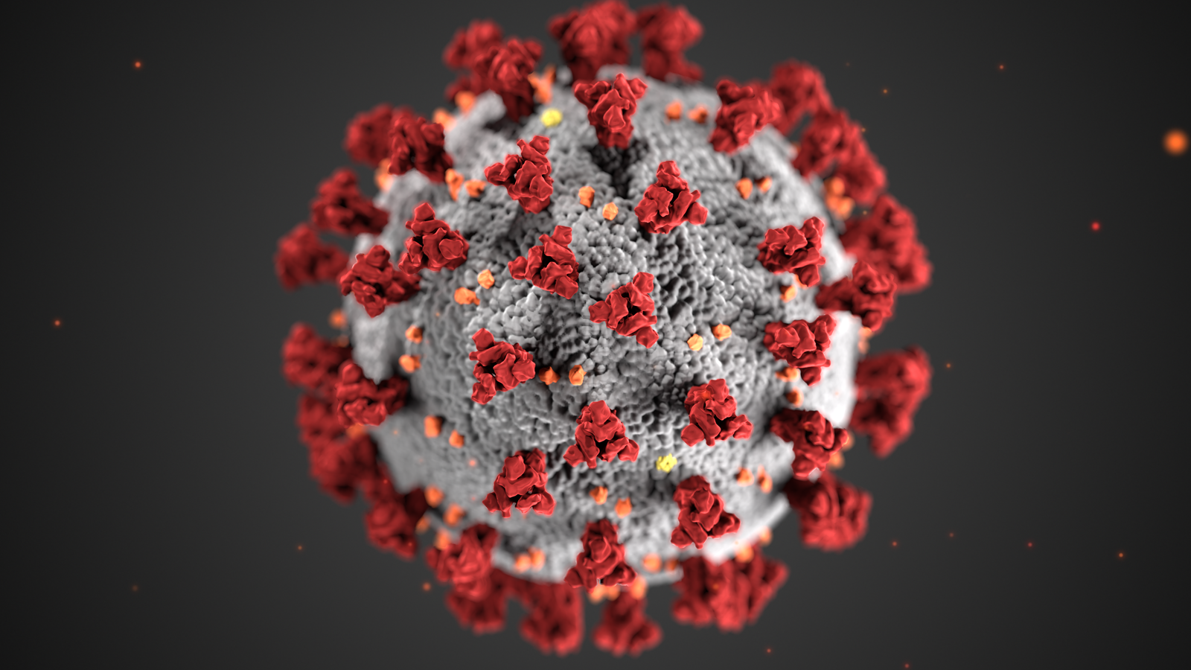
COVID-19 STATUS TRACKER

Slide 2
PROJECT BY: CREATIVE CODERS
Our Team Members
Aparna
Fousiya
Libiya
Sudharsanam
Vaishak

Slide 3
OBJECTIVE
1. To create a web app that displays country and state wise status of:
Total Covid Cases
Active Covid Cases
Recovered Covid Cases
Death Rate
Vaccination Status
2. To create graphical representations of above cases

Slide 4

TOOLS USED
ReactJs
NodeJs
MongoDB
ChartJs
ExpressJs

Slide 5
PAGES
Awareness Page
Sign Up Page
Login Page
Home Page

Slide 6
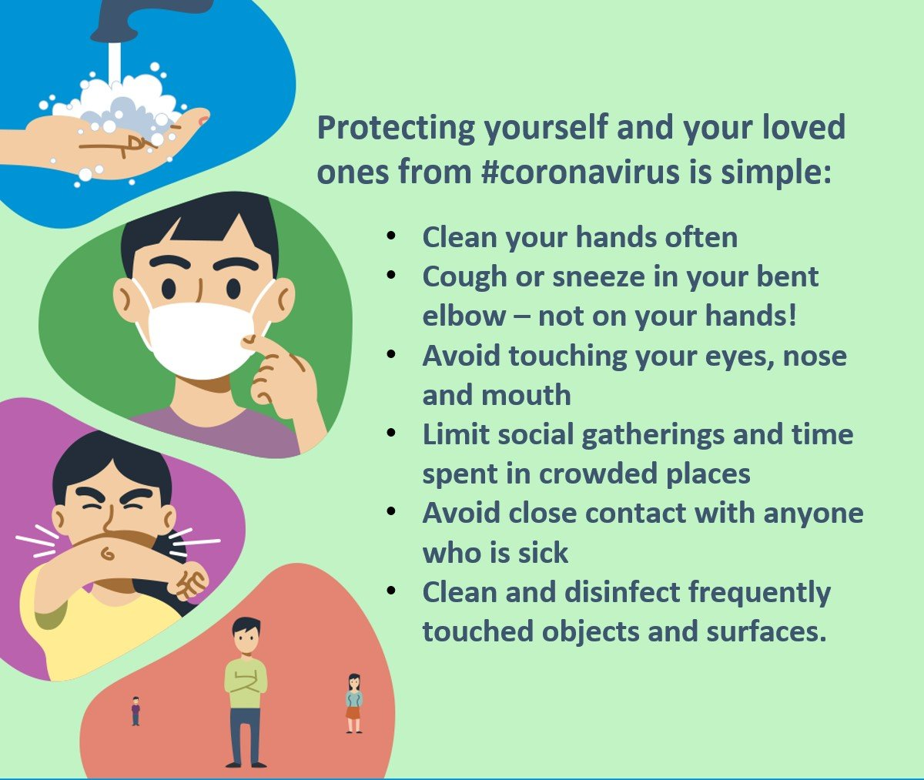
AWARENESS PAGE
Message / Details
Stylesheet – animations

Slide 7
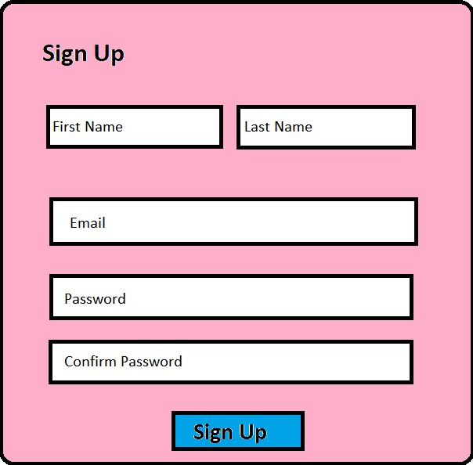
SIGN UP PAGE
A signup page (also known as a registration page) enables users and organizations to independently register and gain access to your system. It is common to have multiple signup pages depending on the types of people and organizations you want to register.

Slide 8
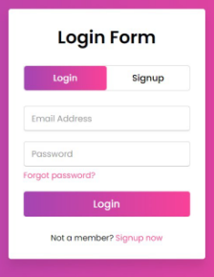
LOGIN FORM
A Login form is used to enter authentication credentials to access a restricted page or form. The login form contains a field for the username and another for the password. When the login form is submitted its underlying code checks that the credentials are authentic, giving the user can access the restricted page.

Slide 9
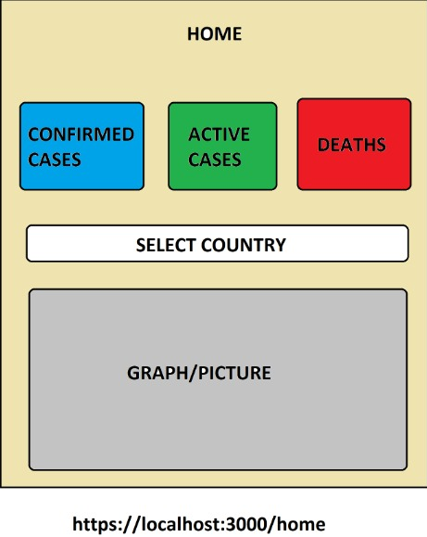
Home Page

Slide 10
Covid Status

Slide 11
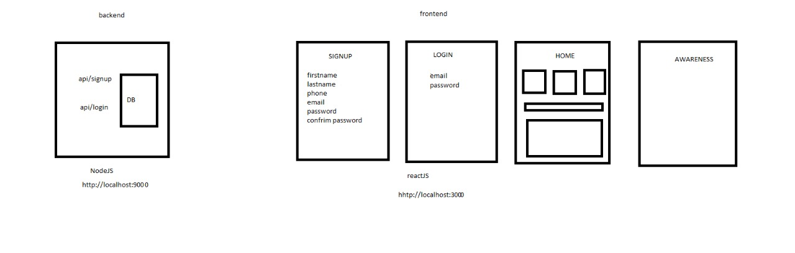
Architecture

Slide 12


